Slide 1
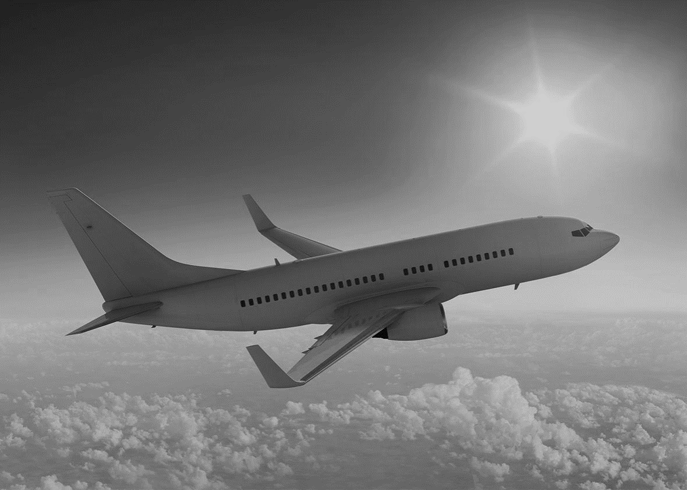

[ ]
Classical and Modern Control Systems for
Small Unmanned Fixed Wing Aircraft
Team sweep angle
2020.05.01

Slide 2
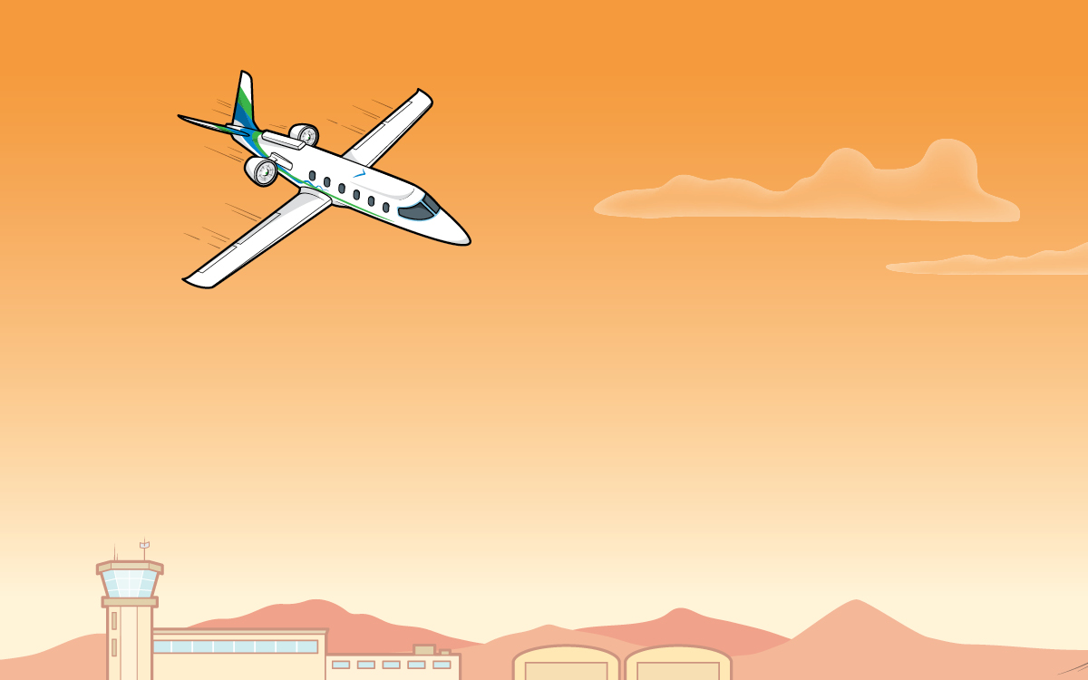
C
ONTENTS
1
Contents 1
2
Contents 2
3
Contents 3
4
Contents 4
5
Contents 5
6
Contents 6

Slide 3

Contents 1

Slide 4
Contents 1

Slide 5
Contents 1

Slide 6
Brian Caskey
Chris Chewning
Christian Manahl
Gage Lochner
Alex Wyatt
Youngro Lee
Victor Perez
HyeokJae Lee
Thank you

